Slide 1
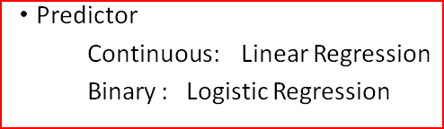
Logistic Regression
Form of regression that allows the prediction of discrete variables by a mix of continuous and discrete predictors

Slide 2
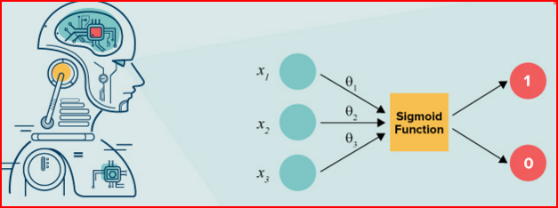
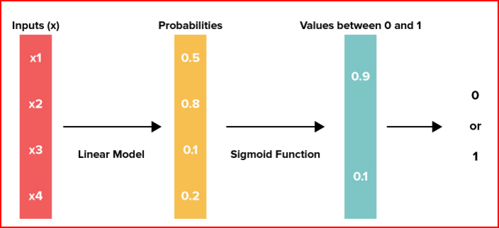

Slide 3
Assumptions
The only “real” limitation on logistic regression is that the outcome must be discrete.

Slide 4
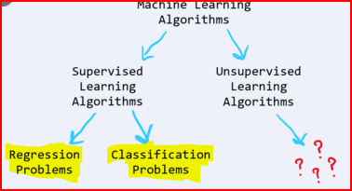
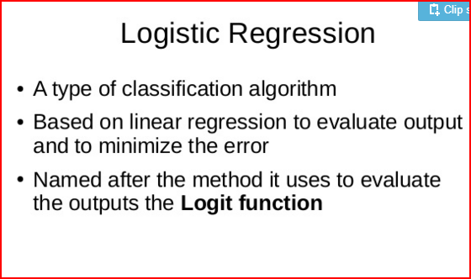

Slide 5
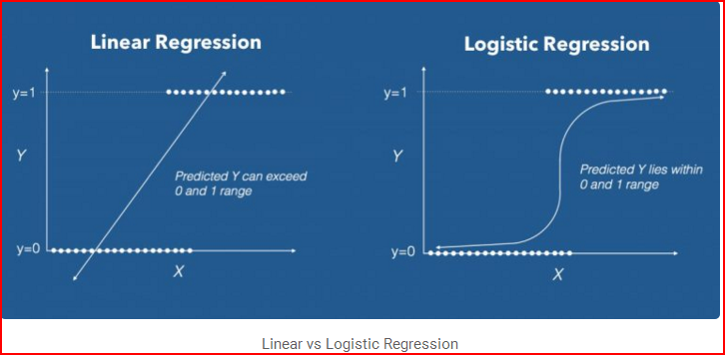
In linear regression the Y variable is always a continuous variable. If suppose, the Y variable was categorical, you cannot use linear regression model it.
Logistic regression is a supervised learning classification algorithm used to predict the probability of a target variable. The nature of target or dependent variable is dichotomous, which means there would be only two possible classes.

Slide 6
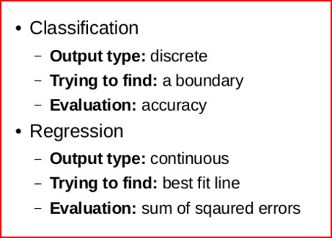
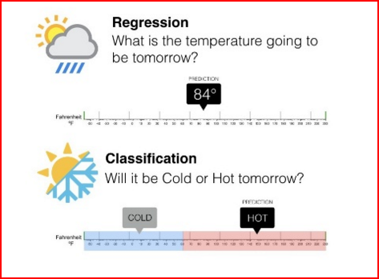

Slide 7
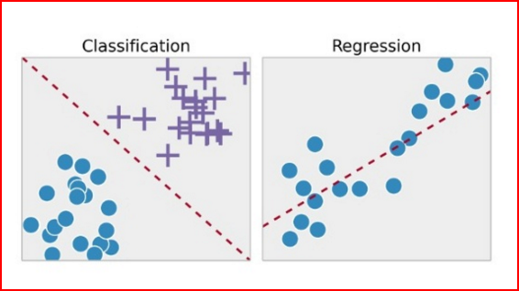

Slide 8
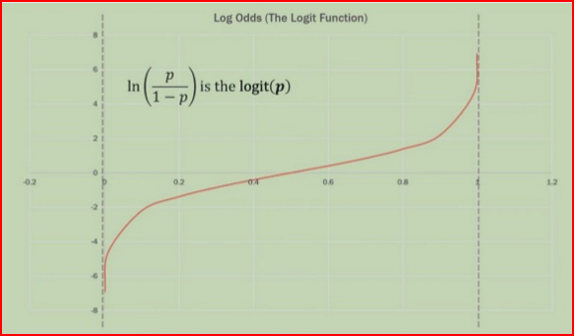

Slide 9
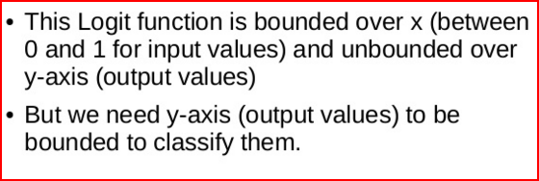
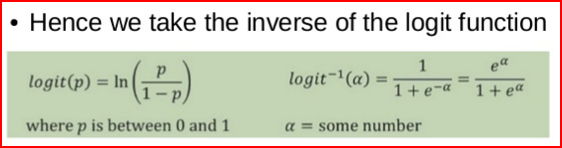
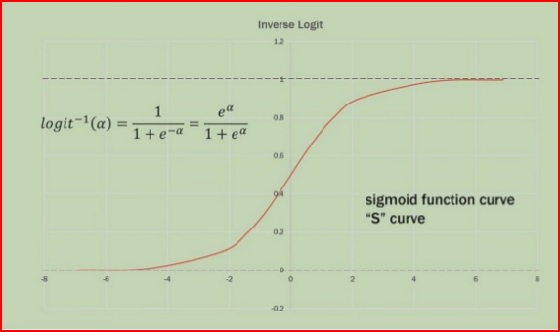

Slide 10
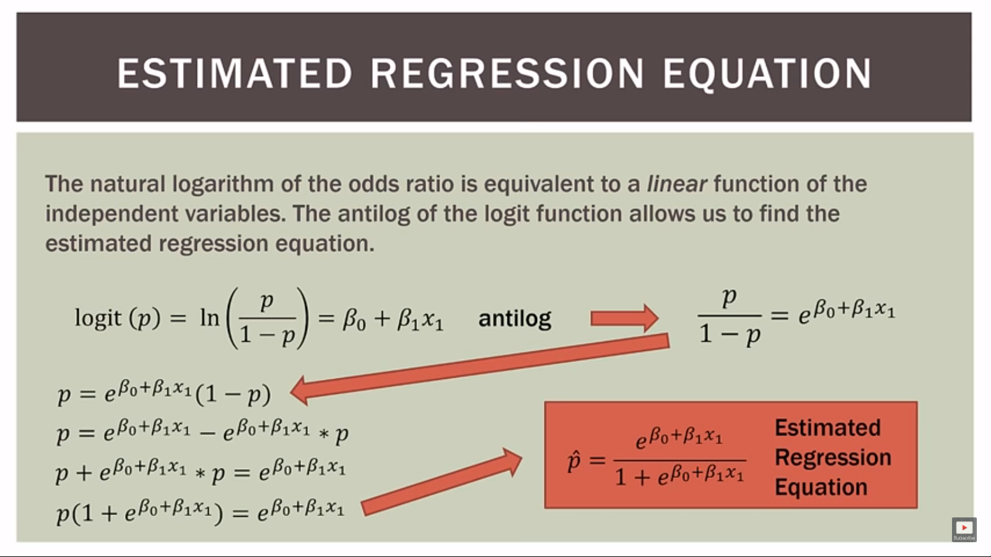

Slide 11
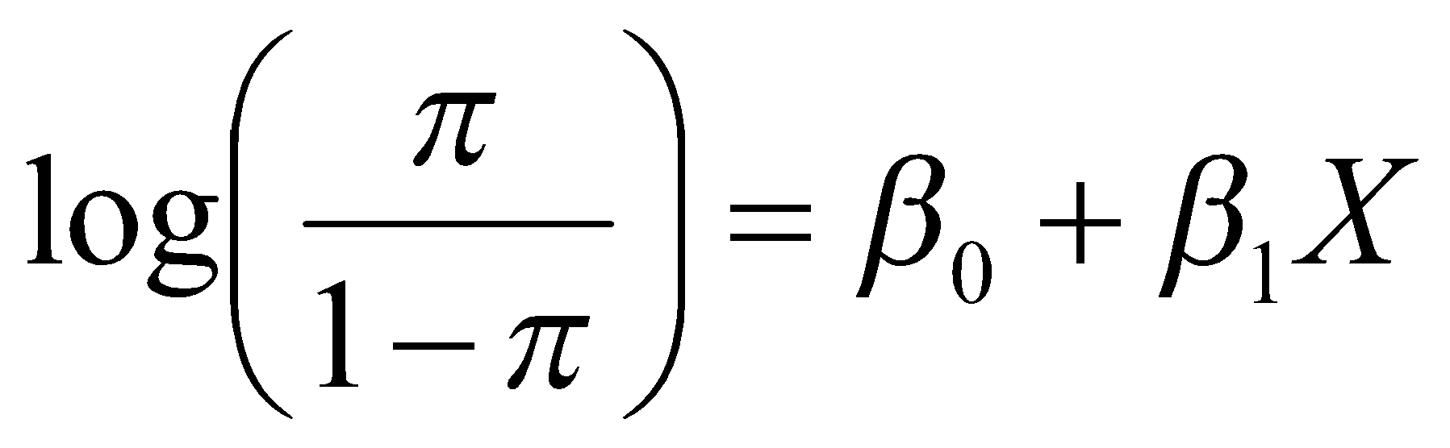
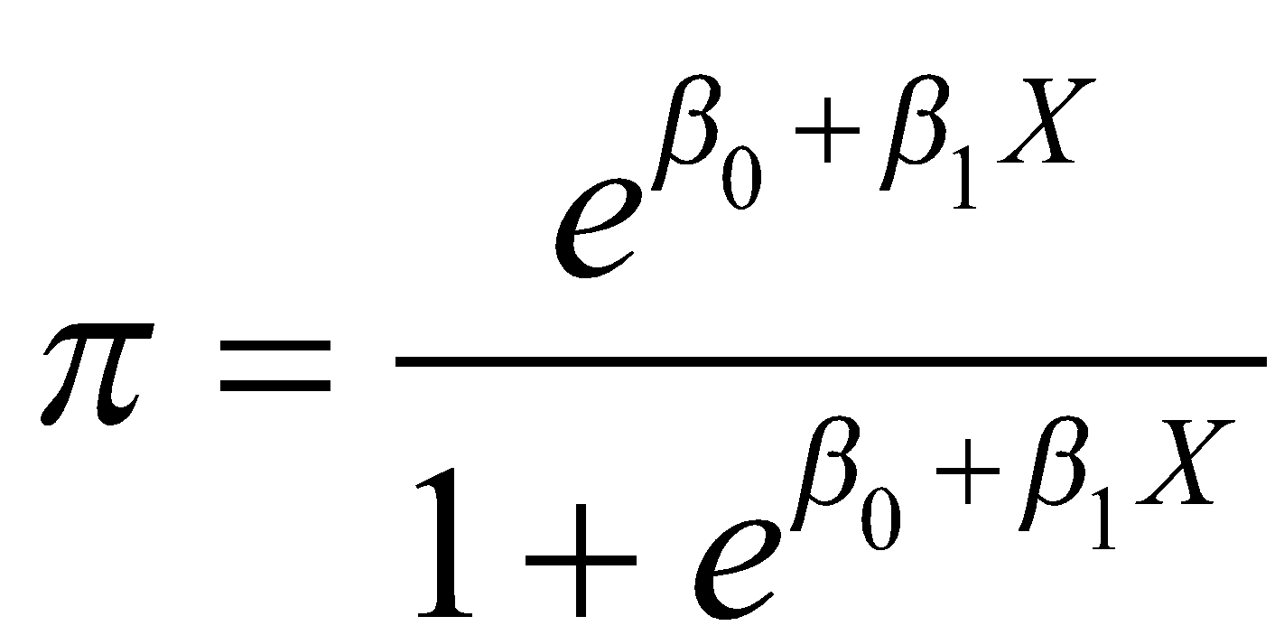
Binary Logistic Regression Model
Y = Binary response
X = Quantitative predictor
π = proportion of 1’s (yes,success) at any X
Equivalent forms of the logistic regression model:
Logit form
Probability form
What does this look like?
N.B.: This is natural log (aka “ln”)

Slide 12
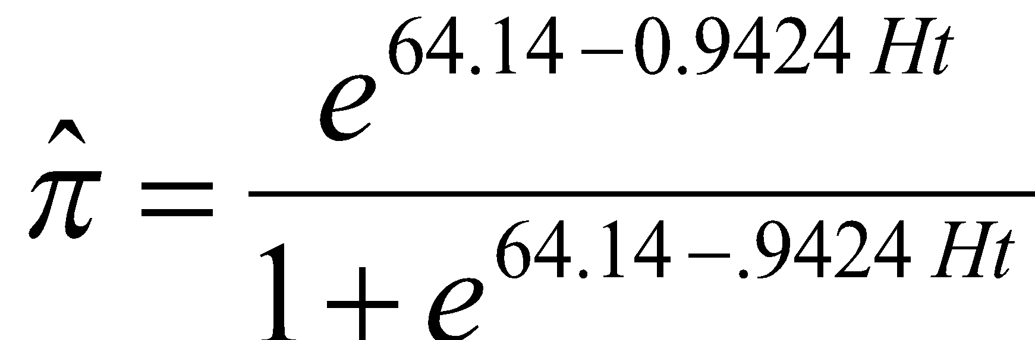
Call:
glm(formula = Gender ~ Hgt, family = binomial, data = Pulse)
Coefficients:
Estimate Std. Error z value Pr(>|z|)
(Intercept) 64.1416 8.3694 7.664 1.81e-14 ***
Hgt -0.9424 0.1227 -7.680 1.60e-14***
---
proportion of females at that Hgt

Slide 13
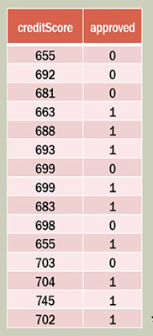
Example1:

Slide 14
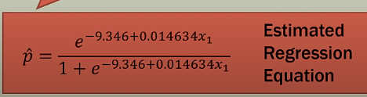

Slide 15
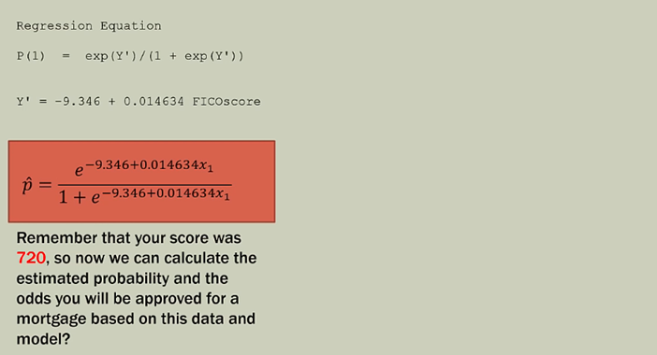

Slide 16
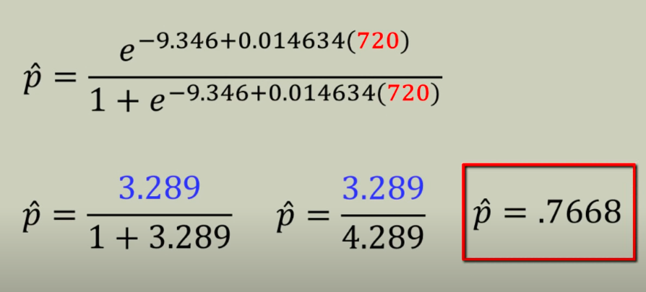

Slide 17
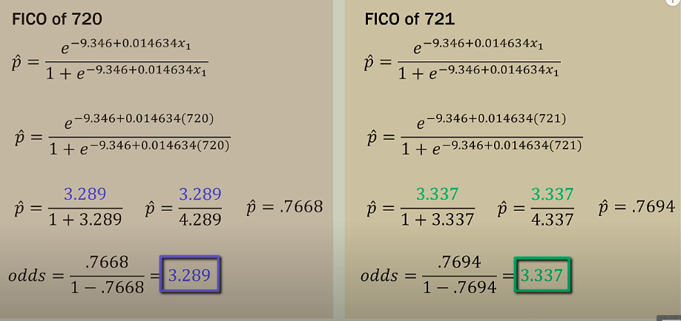

Slide 18
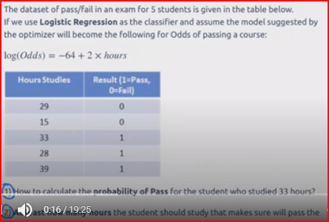
example2

Slide 19
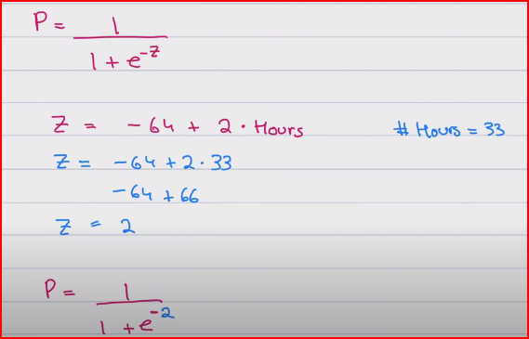
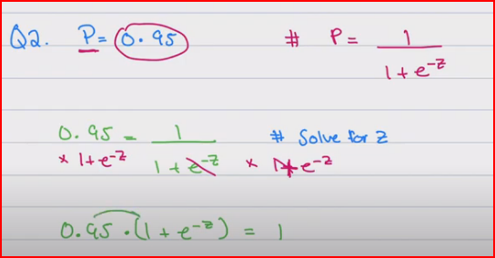

Slide 20
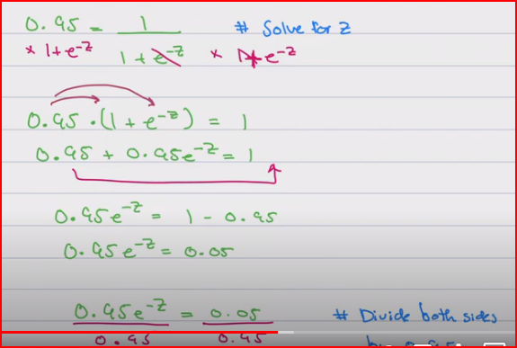
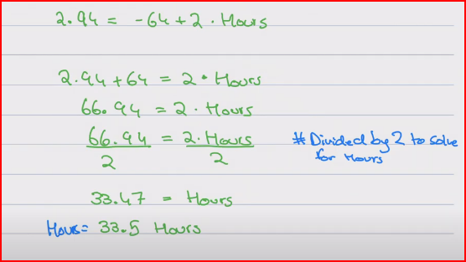

Slide 21
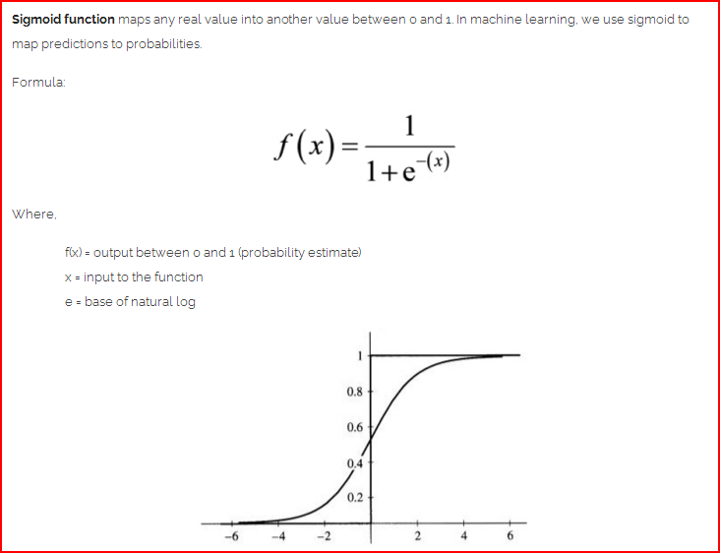

Slide 22
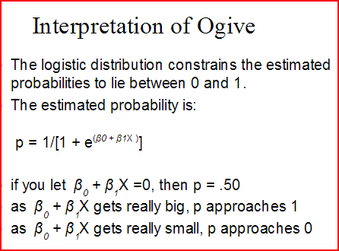

Slide 23
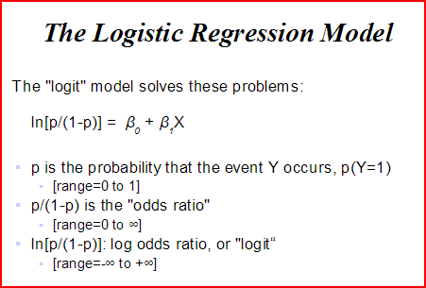

Slide 24
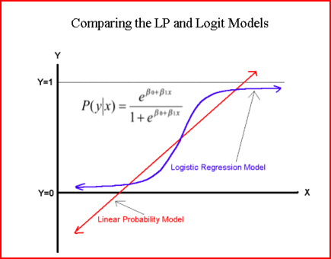

Slide 25
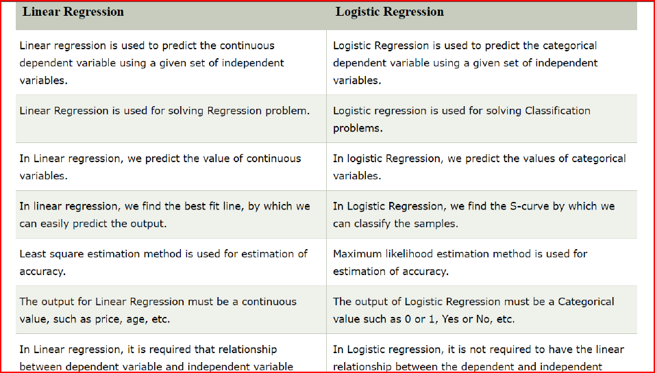

Slide 26
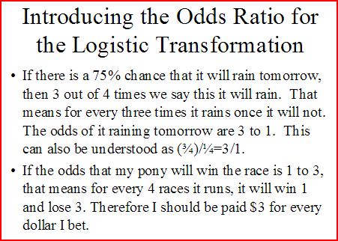

Slide 27
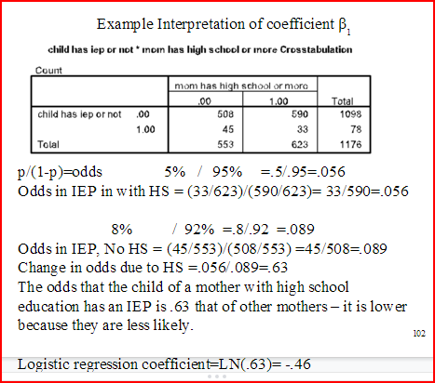

Slide 28
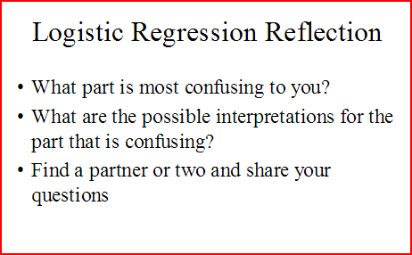

Slide 29
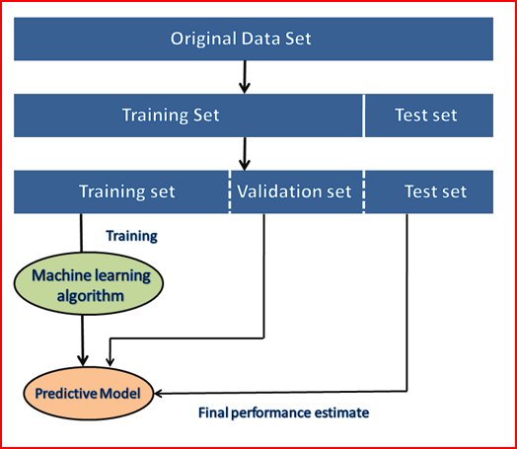

Slide 30
Popular sources for Machine Learning datasets
Below is the list of datasets which are freely available for the public to work on it:
1. Kaggle Datasets
2. UCI Machine Learning Repository
3. Datasets via AWS
. Google's Dataset Search Engine
9. Scikit-learn dataset
7. Government Datasets
8. Computer Vision Datasets

Slide 31
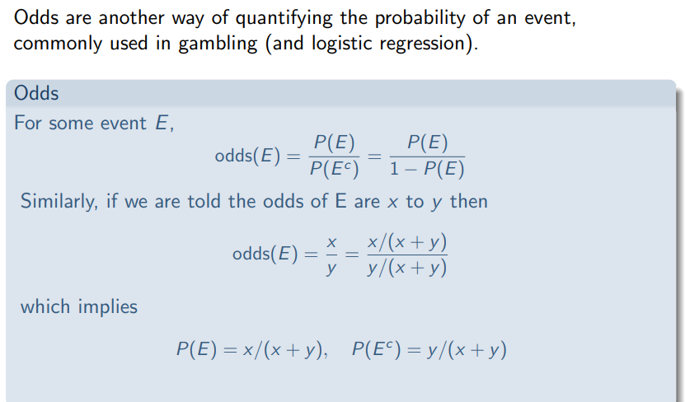

Slide 32
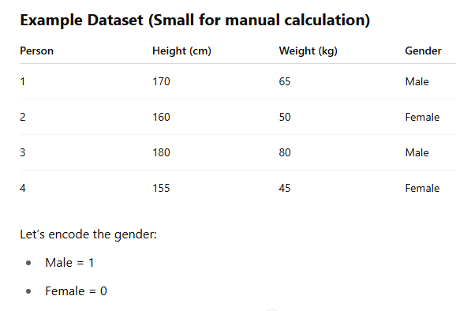

Slide 33
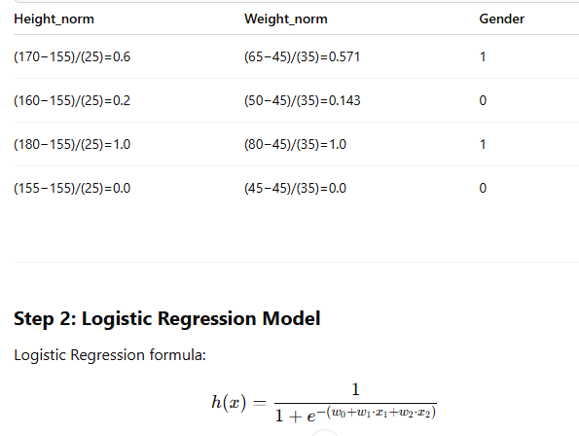

Slide 34
